Slide 1
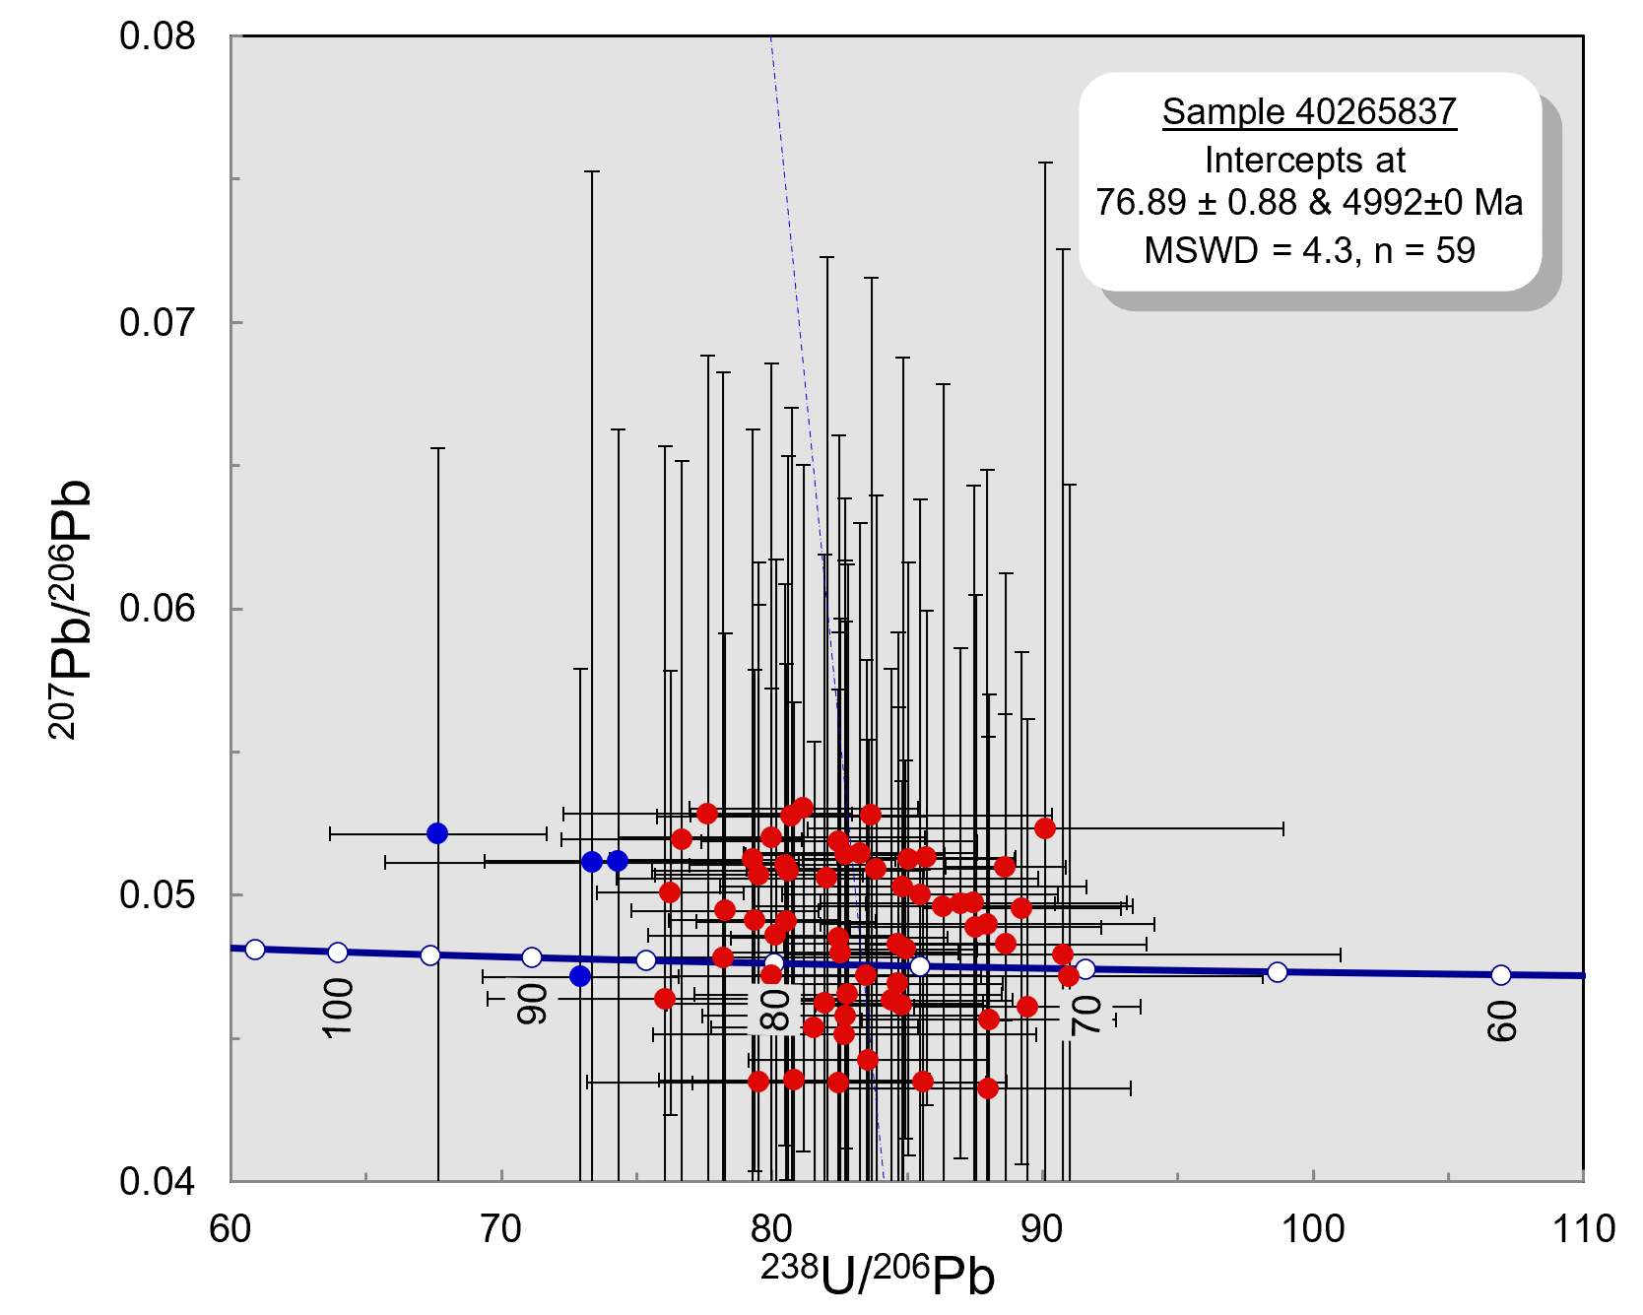
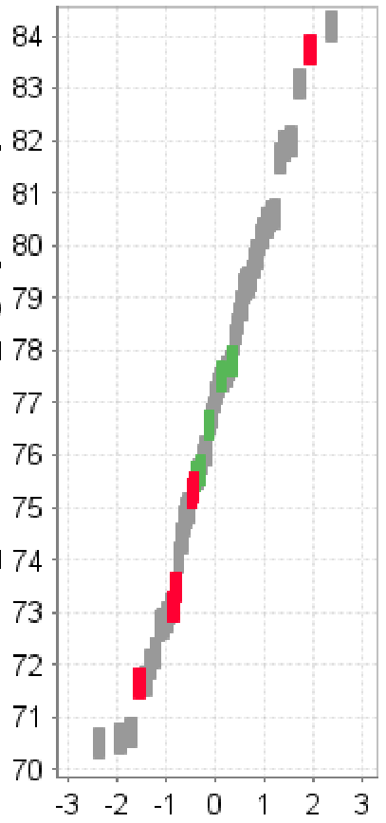
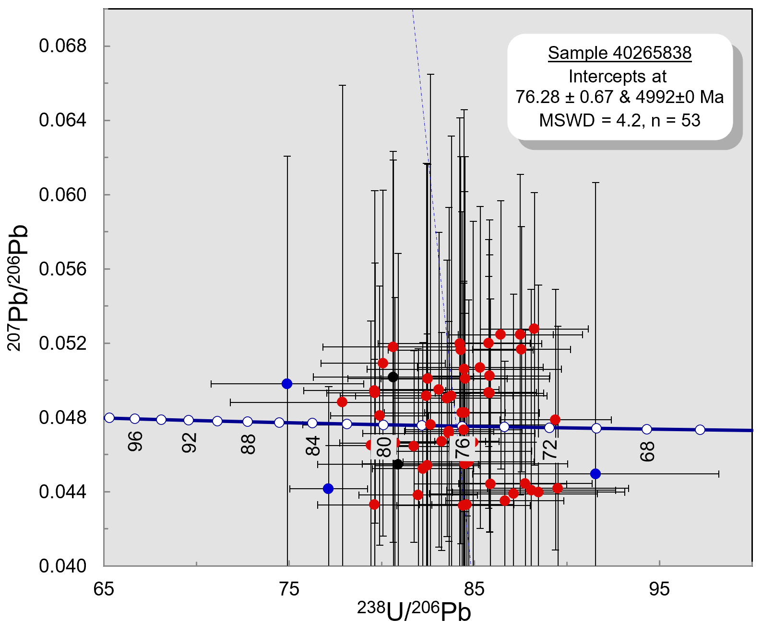
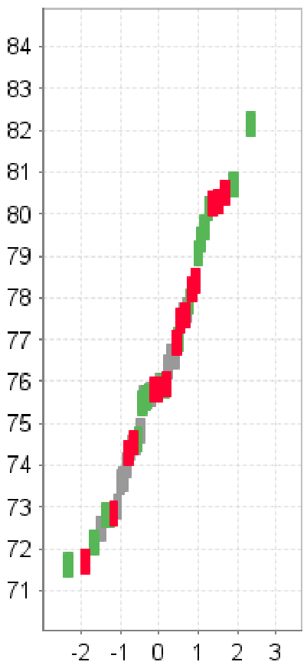
Cash Porphyry – U-Pb LA-ICPMS
40265837
40265837
2 diamond core samples from the Cash prospect were submitted for U-Pb zircon geochronology and fertility assessment:
Both returned marginally older dates compared to the ca. 75-74 Ma porphyry lithologies at Casino.
Sample 40265837 (Kfs-Qz-porphyry) yielded a robust intercept age of 76.89 ± 0.88 Ma
Sample 40265838 (Fsp-porphyry) yielded a robust intercept age of 76.28 ± 0.67 Ma
Age, Ma
40265838
40265838
Age, Ma
TW Concordia plots showing U-Pb isotope ratios for analysed zircons. Red – passed QC, black – failed QC, blue – inheritance/outliers. To the right of each Concordia plot – a normal score plot for a respective sample, showing individual zircon analyses coloured by their RF classification, Y-axis shows age.
Cash U-Pb Geochronology | September 2022

